Slide 1
Instruction manual
Vision

Slide 2
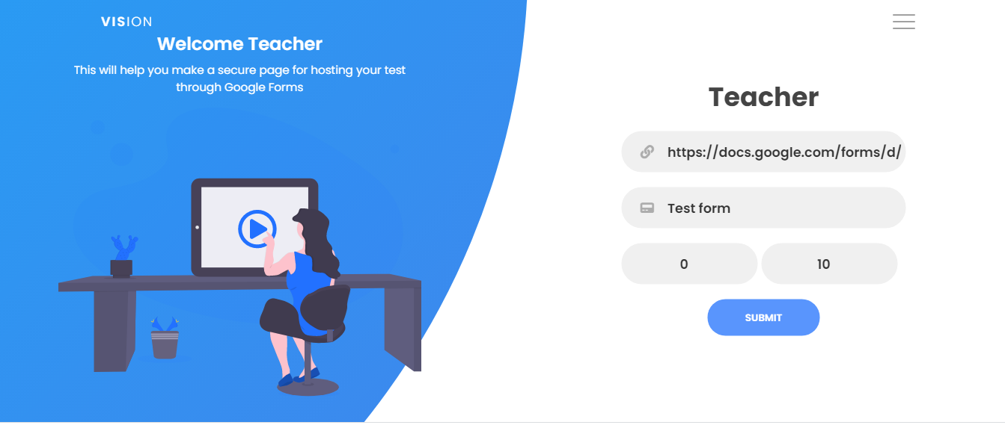
Step 1
Enter form link in the first box
Enter name of the form in second box
Enter duration of examination
Press submit

Slide 3
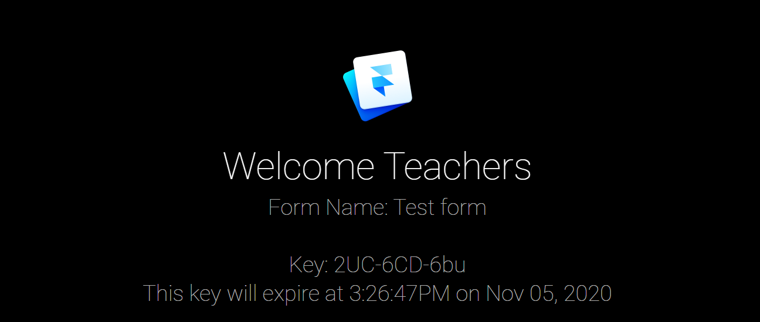
Step 2
Copy the login Key which will appear after pressing submit. This key expires after 3 minutes.
After copying the key exit this page and go to the student page

Slide 4
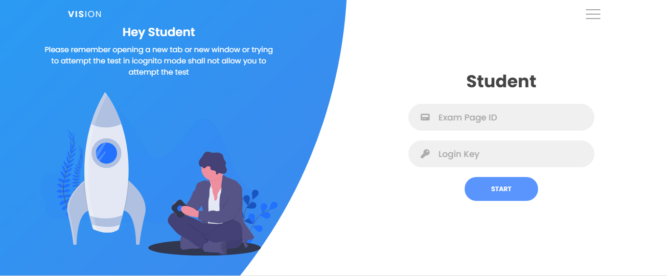
Step 3
Enter the form name in the “Exam page ID” textbox
Paste the login key in the “Login key” textbox

Slide 5

Step 4
After entering the form name in the first box and pasting the key in the second box, press “start” to start the exam
The page will redirect to a secure examination page where a student cannot change tab, window or open another window.

Slide 6
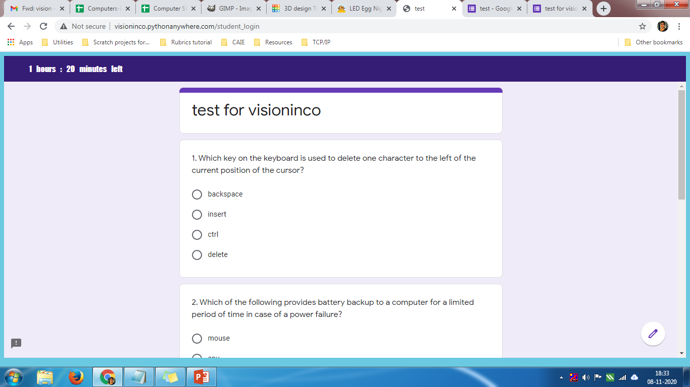
Step 4
The examination page will immediately redirect to the student page if any attempt is made to go to a different tab or open a new window.
After filling the form press submit and the response will be recorded.
* If the key expires, then all the steps have to be repeated to make a different form.

